Slide 1





FG1
Envelope Threshold Detector
~
Electron Signal
1.732 GHz
Electron Signal
422 nm
PI Lasers
390 nm
Vacuum Chamber
MCP
390 nm
AOM
Trap Drive
$$e^{−}$$
Spectrum Analyzer
RF Drive Monitor
Paul Trap
Ca
Oven
Control TTL
Tickling & DC ($±$43V)
Extraction Pulse
DC ($±$10V)
Function Generator
FG2
Tickling Signal
~
1~200 MHz
Switch
Control TTL
ArtiQ
Control TTL

Slide 2
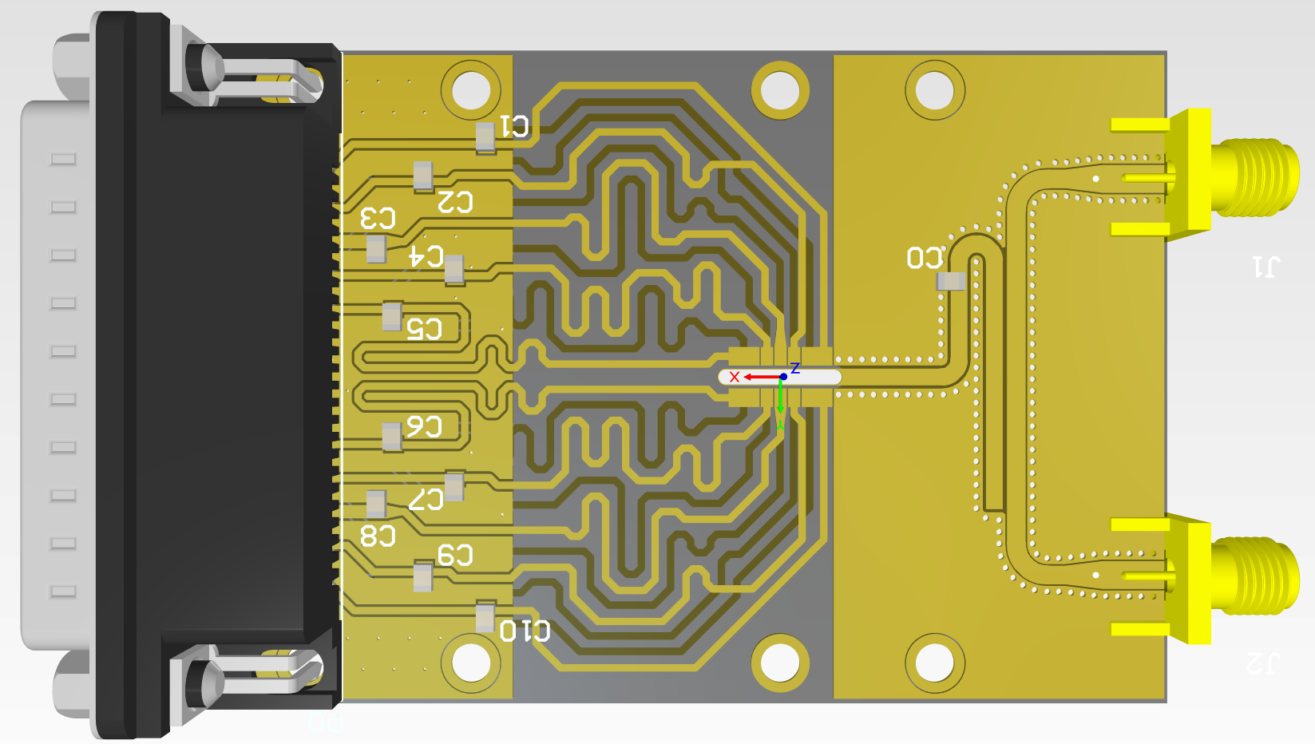
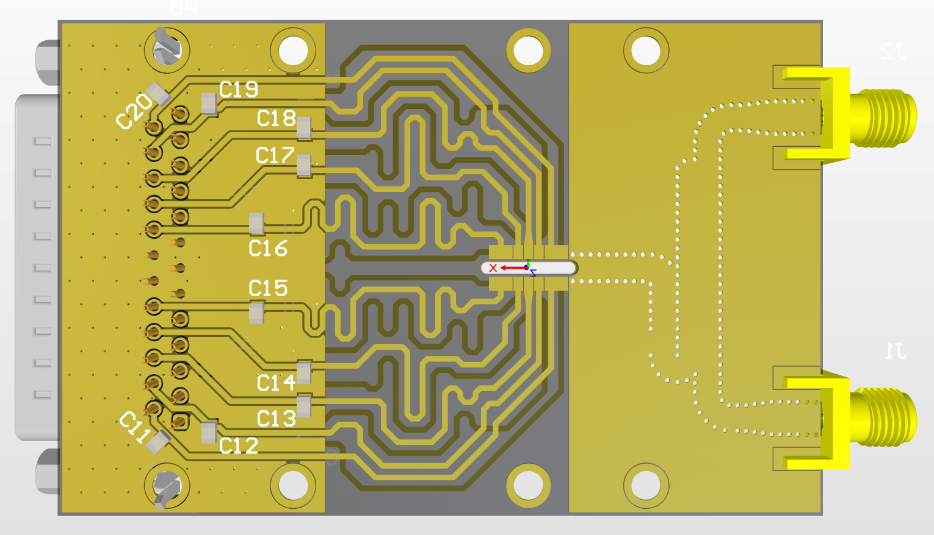

Slide 3
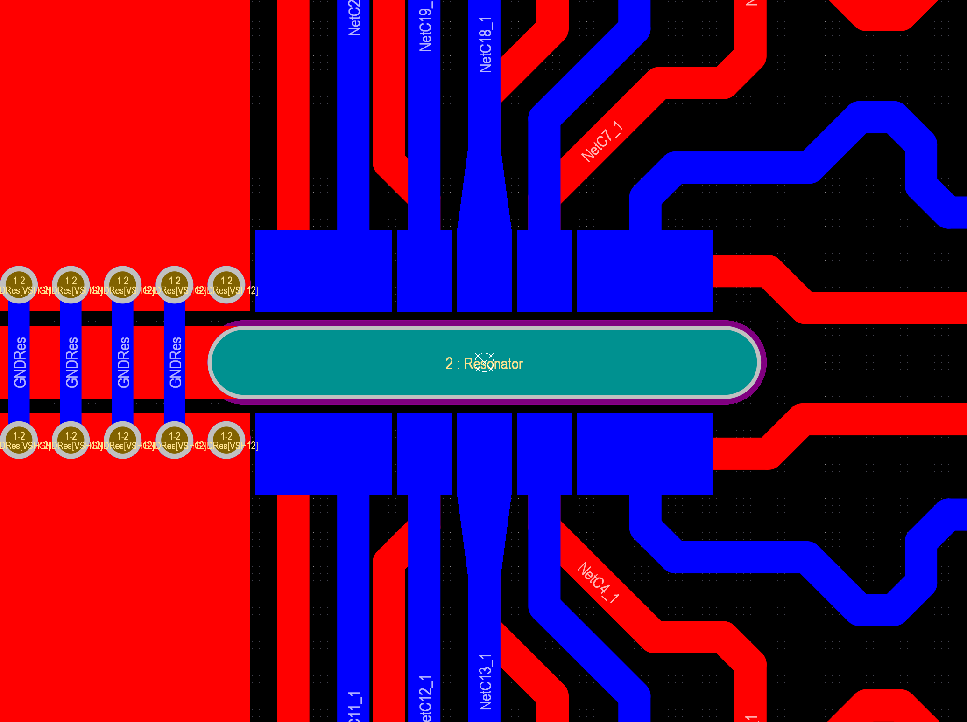
24mil
4mil
1
2
3
4
5
right
100mil
X
60mil
40mil
X
60mil
10mil
16mil
400mil
48mil
54mil
left

Slide 4
